Slide 1
Lecture # 03 Considerations & Requirements for a Housing Scheme

Slide 2
Introduction
A key aim in the design of any housing scheme should be to ensure that it is socially, environmentally and economically sustainable by: providing a high quality environment that meets the needs and, as far as possible, the preferences of the residents and fosters the development of community; achieving energy efficiency both at construction stage and during the lifetime of the scheme, e.g., by climate sensitive design which takes account of the orientation, topography and surrounding features so as to control wind effects, while optimizing the benefits of daylight and solar gain; having due regard to the social and environmental consequences associated with the construction process and the use of materials and resources.

Slide 3
Good Quality; Sustainable Housing Development Should Incorporate & Consider The Following:

Slide 4
Socially and environmentally appropriate
The type of accommodation, support services and amenities provided should be appropriate to the needs of the people to be accommodated.
The mix of dwelling type, size and tenure should support sound social, environmental and economic sustainability policy objectives for the area and promote the development of appropriately integrated play and recreation spaces.
Larger schemes should be designed to accommodate a balanced range of household sizes and types, including apartments, duplex units and sheltered housing, where appropriate.

Slide 5
Architecturally appropriate
The scheme should provide a pleasant living environment, which is aesthetically pleasing and human in scale.
The scheme design solution should understand and respond appropriately to its context so that the development will enhance the neighborhood and respect its cultural heritage.

Slide 6
Accessible and adaptable
There should be ease of access and circulation for all residents, eliminate barriers to accessibility for all users - particularly older people and those with mobility impairment or other disability, enabling them to move as freely as possible within and through the development, to gain access to buildings and to use the services and amenities provided.
The relevant planning and transport authorities should be consulted to ensure that any necessary provision is made in the layout of the scheme for bus routes and bus stops at locations that are convenient for pedestrian access.

Slide 7
Accessible and adaptable
The layout of pedestrian routes should facilitate access to those services; and the layout of the road network should be conducive to effective traffic control and adequate provision should be made for cycle paths, pedestrian routes and natural walkways in the overall design.
The design should aim to minimize vehicle flows and speeds within the housing scheme and to discourage through vehicular traffic.

Slide 8
Safe, secure and healthy
In the planning and design of the scheme, the planner should seek to create a high quality living environment for residents and enhance the social, environmental and visual quality of the area as a whole; seek to ensure a high level of safety and security for the residents.. It should be possible for pedestrians and cyclists to move within and through the area with reasonable ease and in safety.
The layout should be designed to discourage anti-social behavior, e.g., access ways and public areas should be overlooked by dwellings or be otherwise open to casual surveillance by residents; provide safe and convenient access to all dwellings within the scheme and to adjacent facilities and services.

Slide 9
Affordable
The scheme should be capable of being constructed, managed and maintained at reasonable cost and in a way that is economically, socially and environmentally sustainable, e.g.,
by using appropriate indigenous materials,
optimizing the use of infrastructure and minimizing the lengths of roads and service runs, without compromising the quality of design of the scheme;
design public open space so as to maximize its potential benefit to the residents, and promote the concepts of enclosure,
clear separation of public/private realm and good permeability as the means to achieve a high quality living environment.

Slide 10
Durable
The best available construction techniques should be used and key elements of construction should have a service life in the order of sixty years without the need for abnormal repair or replacement works.
The general layout and design of the scheme should aim to minimize potential hazards, e.g., in the treatment of changes of level and of open watercourses that may be retained or created.
Adequate lighting should be provided for roads and pedestrian routes, including routes from public areas to dwelling entrances and from dwellings to external stores.

Slide 11
Resource efficient
Efficient use should be made of land, infrastructure and energy. The location should be convenient to transport, services and amenities. Design and orientation of dwellings should take account of site topography so as to control negative wind effects and optimize the benefits of sunlight, daylight and solar gain; optimum use should be made of renewable sources of energy, the use of scarce natural resources in the construction, maintenance and management of the dwellings should be minimized.
The pattern, structure or arrangement of development blocks, streets, buildings, open space and landscape should be considered while designing a scheme.

Slide 12
Resource efficient
The spatial interrelationship between all these elements (development blocks, streets, buildings, open space and landscape) should be considered while designing a scheme.
Such elements include:
Landmarks
Gateways
Links
Nodes
Edges

Slide 13
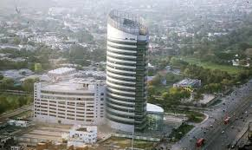
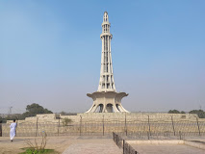
Landmarks
Landmarks are the most recognizable features of an area. They may be historic as in the case of a castle, tower or landscape features such as a tree or a mound, or serve a particular function such as a church, shop or simply comprise a large or prominent building.

Slide 14
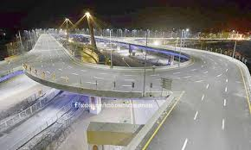
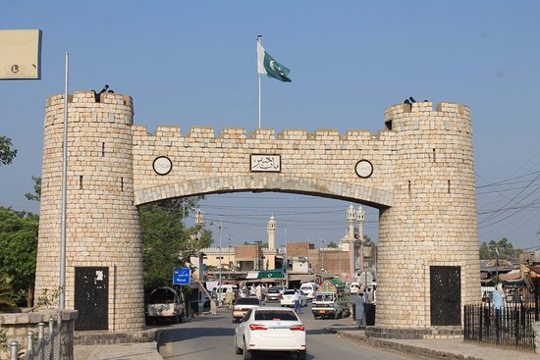
Gateways
They are the points of access, entry or exit between a movement network and an existing or proposed development area. They may include such features as road junctions and access points, railway stations and bridges.

Slide 15
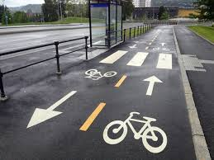
Links
These are the corridors of activity that facilitate movement within and between existing and proposed development areas. They comprise networks that may include public transport routes, roads, streets, footpaths, cycle paths and linear open spaces such as vistas, public walks and routes.

Slide 16
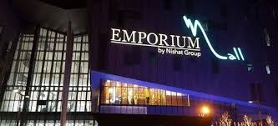
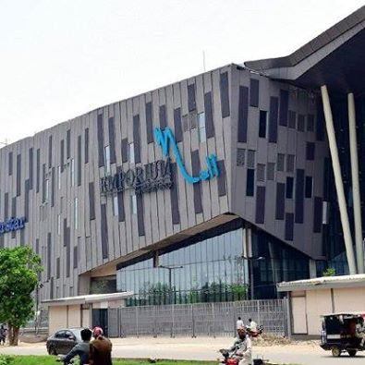
Nodes
Nodes are the generators and hubs of activity that may include such destinations as town, district, and local centers, public spaces, amenities and non-residential uses including schools and childcare facilities. They range in scale from major commercial centers to individual local features such as a crèche or play areas. Mixed-use centers are best located at nodes, and along main movement routes, within walking distance of homes, so as to strengthen their identity.

Slide 17
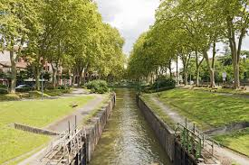
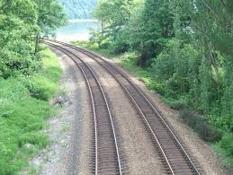
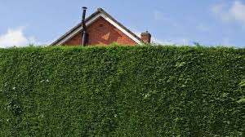
Edges
These are barriers to movement that may contain or define existing or proposed development areas and may include walls, fences, hedges, rivers, canals, major roads, railway lines, large open spaces and overhead power lines. Edges are also an opportunity to create enclosure, to define places and to give character and expression to spaces, both public and private.

Slide 18
Community Facilities and Services
Successful communities require a range of local services and facilities, including employment, commercial, educational, health, spiritual, civic amenities and services such as shops, schools, churches, parks and playing fields, community meeting places, recreation and leisure facilities.
Open spaces can vary in scale and function from nature reserves, woodlands and parks, to squares, courtyards, playgrounds, communal areas, semi-private spaces and private gardens. It may be appropriate to locate play areas and landscaped spaces close to neighborhood centers and to locate playing pitches, tennis courts, etc., close to community centers or on the edge of existing major parks or public open spaces.

Slide 19
Enhancing the Public Realm
The quality of the public realm in cities, towns and villages and within housing schemes is particularly important in the creation of environments in which people want to live and work. The three-dimensional mass of buildings helps to define the public realm.
Designers should take into account the various proportions and scale of development around spaces to ensure high quality in the public realm. Detailed attention to the structure of a space and the elements that it contains is required to create a comfortable and stimulating public realm that encourages social interaction.

Slide 20
Landscaping
Provision should be made for soft and hard landscaping of common open space areas, boundaries and private gardens as appropriate.
Every effort should be made to retain existing trees, shrubs and other landscape features.
Care should be taken to ensure that retained and new trees or other features do not pose a risk of injury to persons or damage to dwellings or other structures.

